Slide 1

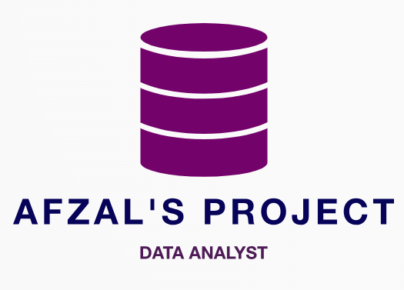
ABC CALL VOLUME TREND ANALYSIS
By: Afzal Alam

Slide 2

INDEX:
PROJECT DESCRIPTION
DATASET
APPROACH
TECH –USED
INSIGHTS
CONCLUSION
RESULTS

Slide 3

PROJECT DESCRIPTION:
In this project, I'll analyze a dataset spanning 23 days from the inbound calling team of a company. The dataset includes details like agent names and IDs, queue times, call times, call durations, and call statuses. Your goal is to derive insights to improve the customer experience. This involves analyzing how long customers wait before connecting with an agent, understanding call outcomes (abandoned, answered, or transferred), and potentially identifying patterns or issues that can be addressed to enhance the overall customer experience.

Slide 4

DATA SET:
ABC Call Volume Trend Analysis
For better result please download

Slide 5

Approach:
I started by downloading the provided data set and took the time to thoroughly understand the columns, descriptions, and requirements of the project. This helped me gain a better understanding of the data and set the foundation for my analysis.
To ensure accurate and meaningful analysis, I performed data cleaning. This involved removing unnecessary columns that were not relevant to the tasks at hand. By cleaning the data, I obtained a clean dataset that served as the basis for my analysis.
Using Excel, I explored the data analysis part of the project. For each task, I utilized pivot tables and graphs to perform the required calculations and generate insights. This allowed me to extract valuable information and patterns from the data set.
Once the data analysis was complete, I shifted my focus to creating the project report. I opted to use PowerPoint for this purpose, where I could present my findings, insights, and visualizations in a concise and visually appealing manner

Slide 6

TECH-STACK USED
Microsoft Excel 365: It enables users to format, organize and calculate data in a spreadsheet. It organize data in an easy-to-navigate way. We need not to perform any complex mathematical functions. And it turn piles of data into helpful graphics and charts

Slide 7

INSIGHTS:
Data Analytics Tasks:
Average Call Duration
Call Volume Analysis
Manpower Planning
Night Shift Manpower Planning

Slide 8

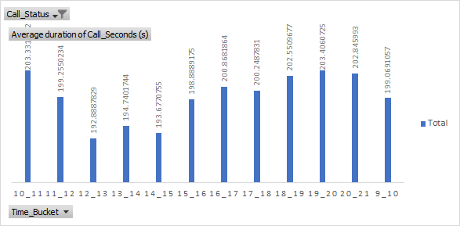
1. AVERAGE CALL TIME DURATION : What is the average duration of calls for each time bucket?
- The highest average call duration was observed in the time buckets 10 to 11, 18 to 19 and 19 to 20 with an average duration of 203 seconds On the other hand, the time bucket 12 to 13 had the lowest average call duration

Slide 9

2. CALL VOLUME: Number of Calls Per Time Bucket:
11 am-2 pm is the busiest 3 hours in an entire day
Highest number of calls is received during 12 pm-1 pm with 9432 calls

Slide 10
3. MANPOWER PLANNING: What is the minimum number of agents required in each time bucket to reduce the abandon rate to 10%?
In order to reduce the abandonment rate to 10%, it was determined that 79 unique agents would be required. Initially, when the abandonment rate was 30% there were 66 unique agents working.
9am-10am and 10am-11am are two time slots that require most number of new agents.

Slide 11

4.NIGHT SHIFT MANPOWER PLANNING: Propose a manpower plan for each time bucket throughout the day, keeping the maximum abandon rate at 10%
It was observed that for every 100 calls made by customers during the 9.00 am to 9.00 pm timeframe, there were also 30 calls made during the night from 9.00 pm to 9.00 am. To handle these night time calls, a manpower of 22 unique agents would be needed

Slide 12
MANPOWER DISTRIBUTION IN DAY:

Slide 13

CONCLUSIONS:
In this project, I analyzed the dataset related to incoming calls received by agents and explored various aspects of agent performance and workload. I considered factors such as agent work schedule, unplanned leaves, working hours, occupied time on calls, and other work tasks.
• Through my analysis, I found that the average call time duration varied across different time buckets, with some time periods experiencing longer call durations compared to others. Additionally, I observed the distribution of incoming calls across different time buckets, with certain time periods receiving a higher volume of calls.
Overall, this project provided valuable insights into agent performance, call distribution, and manpower planning. By implementing the proposed manpower plan, the organization can improve customer service, reduce the abandon rate, and ensure efficient utilization of agent resources

Slide 14

The project helped in understanding how to analyse call centre data and make effective insights
Further strengthening of understanding of Charts and Pivot tables in excel.
The project helped in giving a glimpse of a high-stake problem where customer satisfaction and profitability needs to be kept in mind along with how the jobs of people are in balance. The Project helps in understanding how to handle this

Slide 15


